Slide 1
A Systematic Review of the Research on Information Systems in Environmental Sustainability context
Mukul Kaushik
BADM 504 Philosophy of Science and Business Administration, 12/04/2023

Slide 2
Agenda
Introduction
Selection Criteria
Analysis
Systematic Review - Summary
Opportunities for Further Research
BADM 504 Philosophy of Science and Business Administration, 12/04/2023

Slide 3
Agenda
Introduction
Selection Criteria
Analysis
Systematic Review - Summary
Opportunities for Further Research
BADM 504 Philosophy of Science and Business Administration, 12/04/2023

Slide 4
What is Sustainability?
BADM 504 Philosophy of Science and Business Administration, 12/04/2023
Notes:
Hidden as not really necessary for this

Slide 5
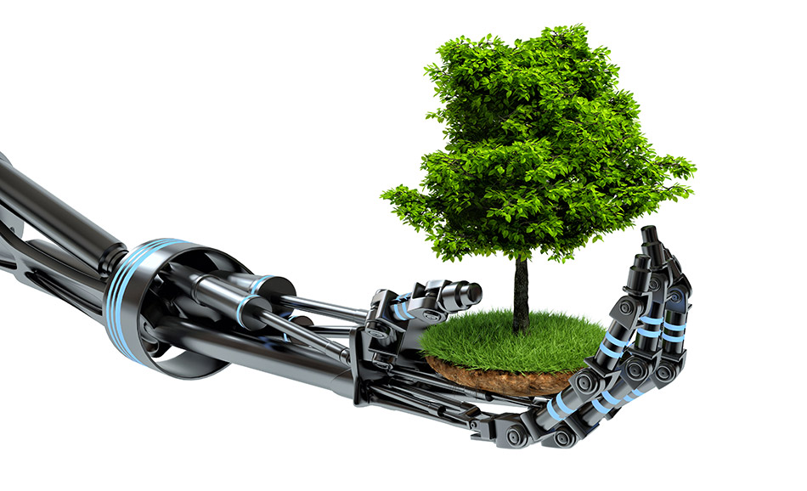
Why Environmental Sustainability?
Worldwide research focus on environmental sustainability in past decades due to increased public awareness
Increased availability of data given adoption of Information Technology in the industry, characterized by Industry 4.0
NGOs such as Carbon Disclosure Project (CDP) making sustainability disclosures available to researchers
BADM 504 Philosophy of Science and Business Administration, 12/04/2023

Slide 6
Agenda
Introduction
Selection Criteria
Analysis
Systematic Review - Summary
Opportunities for Further Research
BADM 504 Philosophy of Science and Business Administration, 12/04/2023

Slide 7
Algorithm For selection
Database: Web of Science
Articles with 20 or more citations fulfilling the following criteria:
Topic (title, abstract and keywords) must contain ALL the following
“sustainab-” or “environment-”
“climate change” or “natural environment” or “green”
“corporate” of “firm” or “company” or “industry” or “business” or “manager-” or “organization-”
“information technology” or “information systems” or “machine learning” or “artificial intelligence”
Title must contain
"attention" or "response" or "invest-" or "performance" or "strategy" or "report" or "disclos-" or "driver" or "motivation" or "barrier" or "innovat-" or "determin-"
Excluded the emerging markets – China, India, Pakistan, Indonesia, Vietnam
BADM 504 Philosophy of Science and Business Administration, 12/04/2023
Notes:
https://www.webofscience.com/wos/woscc/summary/8853cb02-aa6b-42c8-bac0-36843025a324-b9d65fe8/times-cited-descending/1
((TS=(sustainab* OR environment*)
AND TI=(attention OR response OR invest* OR performance OR strategy OR report OR disclos* OR driver OR motivation OR barrier OR innovat* OR determin*))
AND TS=("climate change" OR "natural environment" OR "green")
AND TS=(corporate OR firm OR company OR industry OR business OR manager* OR organization*)
AND TS=("information technology" OR "information systems" OR "machine learning" OR "artificial intelligence"))

Slide 8
Agenda
Introduction
Selection Criteria
Analysis
Systematic Review - Summary
Opportunities for Further Research
BADM 504 Philosophy of Science and Business Administration, 12/04/2023

Slide 9
Articles by Journals
BADM 504 Philosophy of Science and Business Administration, 12/04/2023

Slide 10
Articles by Research Area
BADM 504 Philosophy of Science and Business Administration, 12/04/2023

Slide 11
Articles by Year of Publication
BADM 504 Philosophy of Science and Business Administration, 12/04/2023

Slide 12
Articles by type
BADM 504 Philosophy of Science and Business Administration, 12/04/2023

Slide 13
Agenda
Introduction
Selection Criteria
Analysis
Systematic Review - Summary
Opportunities for Further Research
BADM 504 Philosophy of Science and Business Administration, 12/04/2023

Slide 14
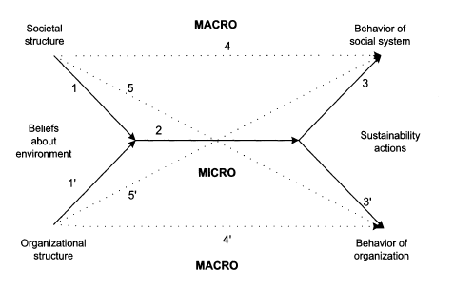
Belief-Action-Outcome (BAO) Framework
(Melville, N. P. ,2010)
BADM 504 Philosophy of Science and Business Administration, 12/04/2023

Slide 15
Belief – What makes firms interested in green IT/IS
Two papers (Hertel, M; Wiesent, J, 2013; Chung, CJ; Wee, HM, 2010) propose new analytical models to guide investments into green IT initiatives
One theory paper (Marcus, A; Malen, J; Ellis, S, 2013) shows that VC firms invest only when sustainability oriented innovations also have a financial promise
One case study (Radu, C; Caron, MA; Arroyo, P, 2020) classifies firms into clusters based on their sustainability process adoption, like passive observers, regulation followers, proactive leaders
14 survey-based papers show that motivation to invest is bottom up – awareness of IT employees, customers, activism by community, knowledge sharing, etc.
BADM 504 Philosophy of Science and Business Administration, 12/04/2023

Slide 16
Action – What enables firms to adopt green practices
Firms invest in green initiatives like green IS, as it gives them a reason to innovate simultaneously into other areas like lean manufacturing (Yang, MG; Hong, P; Modi, SB, 2011)
Firms invest in green initiatives to mitigate environment uncertainty (Wu, GC, 2013)
9 other papers show IT/IS enable firms to adopt green practices –
IT/IS help in knowledge management (Lim, MK; Tseng, ML; Tan, KH; Bui, TD, 2017)
Big data/cloud computing help in coordination between links in the supply chain for all aspects, including sustainability initiatives (Koo, C; Chung, N; Ryoo, SY, 2014)
IT/IS makes practices and performance visible to the stakeholders, resulting in better confidence (Bellamy, MA; Dhanorkar, S; Subramanian, R, 2020)
BADM 504 Philosophy of Science and Business Administration, 12/04/2023

Slide 17
Outcome – What are the outcomes of these practices?
11 studies show adoption of environment-oriented practices results in better organizational performance and creates competitive advantage
In most of the cases, green IT practices have a mediating effect on the above relationship
One study (Anthony, B, 2020) only explores environmental performance and shows IT/IS have a mediating relationship
Two more studies (Schniederjans, DG; Hales, DN, 2016; Forés, B, 2019) only explore environmental performance and show mixed results, and advocate a top-down approach
BADM 504 Philosophy of Science and Business Administration, 12/04/2023

Slide 18
Summary
Empirical research shows that adoption of sustainability practices by firms is linked to superior performance – economic, financial and environmental
Information Systems and Green IT have a mediating effect on the above relationship
However, the driver for adoption of sustainability practices is not expected performance, but the awareness of stakeholders –
Employees
Consumers
Customers
Community activism
BADM 504 Philosophy of Science and Business Administration, 12/04/2023

Slide 19
Agenda
Introduction
Selection Criteria
Analysis
Systematic Review - Summary
Opportunities for Further Research
BADM 504 Philosophy of Science and Business Administration, 12/04/2023

Slide 20
Opportunities for Further Research
Most of the papers here are survey based, which may result in common methods bias, which creates an opportunity for triangulation with some secondary data
None of the papers here consider regulatory environment, which is another area which can be explored
Effect of transparency and green IT can be explored on outsourcing decisions
Link between green messaging for products and adoption of green practices internally may be studied
BADM 504 Philosophy of Science and Business Administration, 12/04/2023

Slide 21
Questions?
BADM 504 Philosophy of Science and Business Administration, 12/04/2023

Slide 22
References
Ainin, S., Naqshbandi, M. M., & Dezdar, S. (2016). Impact of adoption of Green IT practices on organizational performance. Quality & Quantity, 50(5), 1929–1948. https://doi.org/10.1007/s11135-015-0244-7
Ajamieh, A., Benitez, J., Braojos, J., & Gelhard, C. (2016). IT infrastructure and competitive aggressiveness in explaining and predicting performance. Journal Of Business Research, 69(10), 4667–4674. https://doi.org/10.1016/j.jbusres.2016.03.056
Anthony Jr., B. (2019). Green information system integration for environmental performance in organizations: An extension of belief-action-outcome framework and natural resource-based view theory. Benchmarking-An International Journal, 26(3), 1033–1062. https://doi.org/10.1108/BIJ-05-2018-0142
Anthony Jr., B. (2020). Examining the role of green IT/IS innovation in collaborative enterprise-implications in an emerging economy. Technology In Society, 62. https://doi.org/10.1016/j.techsoc.2020.101301
Bag, S., Gupta, S., Kumar, S., & Sivarajah, U. (2021). Role of technological dimensions of green supply chain management practices on firm performance. Journal Of Enterprise Information Management, 34(1, SI), 1–27. https://doi.org/10.1108/JEIM-10-2019-0324
Bellamy, M. A., Dhanorkar, S., & Subramanian, R. (2020). Administrative environmental innovations, supply network structure, and environmental disclosure. Journal Of Operations Management, 66(7–8, SI), 895–932. https://doi.org/10.1002/joom.1114
Bengtsson, F., & Agerfalk, P. J. (2011). Information technology as a change actant in sustainability innovation: Insights from Uppsala. Journal Of Strategic Information Systems, 20(1, SI), 96–112. https://doi.org/10.1016/j.jsis.2010.09.007
Benites-Lazaro, L. L., Giatti, L., & Giarolla, A. (2018). Sustainability and governance of sugarcane ethanol companies in Brazil: Topic modeling analysis of CSR reporting. Journal Of Cleaner Production, 197(1), 583–591. https://doi.org/10.1016/j.jclepro.2018.06.212
BADM 504 Philosophy of Science and Business Administration, 12/04/2023

Slide 23
References (contd.)
Benitez-Amado, J., Nieves Perez-Arostegui, M., & Tamayo-Torres, J. (2010). INFORMATION TECHNOLOGY-ENABLED INNOVATIVENESS AND GREEN CAPABILITIES. Journal Of Computer Information Systems, 51(2), 87–96.
Benitez-Amado, J., & Walczuch, R. M. (2012). Information technology, the organizational capability of proactive corporate environmental strategy and firm performance: a resource-based analysis. European Journal Of Information Systems, 21(6), 664–679. https://doi.org/10.1057/ejis.2012.14
Benzidia, S., Makaoui, N., & Bentahar, O. (2021). The impact of big data analytics and artificial intelligence on green supply chain process integration and hospital environmental performance. Technological Forecasting And Social Change, 165. https://doi.org/10.1016/j.techfore.2020.120557
Carberry, E. J., Bharati, P., Levy, D. L., & Chaudhury, A. (2019). Social Movements as Catalysts for Corporate Social Innovation: Environmental Activism and the Adoption of Green Information Systems. Business & Society, 58(5, SI), 1083–1127. https://doi.org/10.1177/0007650317701674
Chuang, S.-P., & Huang, S.-J. (2018). The Effect of Environmental Corporate Social Responsibility on Environmental Performance and Business Competitiveness: The Mediation of Green Information Technology Capital. Journal Of Business Ethics, 150(4), 991–1009. https://doi.org/10.1007/s10551-016-3167-x
Chung, C.-J., & Wee, H.-M. (2010). Green-product-design value and information-technology investment on replenishment model with remanufacturing. International Journal Of Computer Integrated Manufacturing, 23(5), 466–485. https://doi.org/10.1080/09511921003667714
De Lucia, C., Pazienza, P., & Bartlett, M. (2020). Does Good ESG Lead to Better Financial Performances by Firms? Machine Learning and Logistic Regression Models of Public Enterprises in Europe. Sustainability, 12(13). https://doi.org/10.3390/su12135317
El-Kassar, A.-N., & Singh, S. K. (2019). Green innovation and organizational performance: The influence of big data and the moderating role of management commitment and HR practices. Technological Forecasting And Social Change, 144, 483–498. https://doi.org/10.1016/j.techfore.2017.12.016
BADM 504 Philosophy of Science and Business Administration, 12/04/2023

Slide 24
References (contd.)
Fores, B. (2019). Beyond Gathering the `Low-Hanging Fruit’ of Green Technology for Improved Environmental Performance: an Empirical Examination of the Moderating Effects of Proactive Environmental Management and Business Strategies. Sustainability, 11(22). https://doi.org/10.3390/su11226299
Gholami, R., Sulaiman, A. B., Ramayah, T., & Molla, A. (2013). Senior managers’ perception on green information systems (IS) adoption and environmental performance: Results from a field survey. Information & Management, 50(7), 431–438. https://doi.org/10.1016/j.im.2013.01.004
Green Jr., K. W., Zelbst, P. J., & Bhadauria Vikram S. and Meacham, J. (2012). Do environmental collaboration and monitoring enhance organizational performance? Industrial Management & Data Systems, 112(1–2), 186–205. https://doi.org/10.1108/02635571211204254
Green Jr., K. W., Zelbst, P. J., Meacham, J., & Bhadauria, V. S. (2012). Green supply chain management practices: impact on performance. Supply Chain Management-An International Journal, 17(3), 290–305. https://doi.org/10.1108/13598541211227126
Hanelt, A., Busse, S., & Kolbe, L. M. (2017). Driving business transformation toward sustainability: exploring the impact of supporting IS on the performance contribution of eco-innovations. Information Systems Journal, 27(4, SI), 463–502. https://doi.org/10.1111/isj.12130
Hartmann, J., & Germain, R. (2015). Understanding the relationships of integration capabilities, ecological product design, and manufacturing performance. Journal Of Cleaner Production, 92, 196–205. https://doi.org/10.1016/j.jclepro.2014.12.079
Hedman, J., & Henningsson, S. (2016). Developing ecological sustainability: a green IS response model. Information Systems Journal, 26(3), 259–287. https://doi.org/10.1111/isj.12095
Hertel, M., & Wiesent, J. (2013). Investments in information systems: A contribution towards sustainability. Information Systems Frontiers, 15(5), 815–829. https://doi.org/10.1007/s10796-013-9417-x
BADM 504 Philosophy of Science and Business Administration, 12/04/2023

Slide 25
References (contd.)
Hu, P. J.-H., Hu, H.-F., Wei, C.-P., & Hsu, P.-F. (2016). Examining Firms’ Green Information Technology Practices: A Hierarchical View of Key Drivers and Their Effects. Journal Of Management Information Systems, 33(4), 1149–1179. https://doi.org/10.1080/07421222.2016.1267532
Huang, Y.-C., Ding, H.-B., & Kao, M.-R. (2009). Salient stakeholder voices: Family business and green innovation adoption. Journal Of Management & Organization, 15(3), 309–326. https://doi.org/10.5172/jmo.2009.15.3.309
Koo, C., Chung, N., & Ryoo, S. Y. (2014). How does ecological responsibility affect manufacturing firms’ environmental and economic performance? Total Quality Management & Business Excellence, 25(9–10), 1171–1189. https://doi.org/10.1080/14783363.2013.835615
Leal-Millan, A., Luis Roldan, J., Leal-Rodriguez, A. L., & Ortega-Gutierrez, J. (2016). IT and relationship learning in networks as drivers of green innovation and customer capital: evidence from the automobile sector. Journal Of Knowledge Management, 20(3), 444–464. https://doi.org/10.1108/JKM-05-2015-0203
Lim, M. K., Tseng, M.-L., Tan, K. H., & Bui, T. D. (2017). Knowledge management in sustainable supply chain management: Improving performance through an interpretive structural modelling approach. Journal Of Cleaner Production, 162, 806–816. https://doi.org/10.1016/j.jclepro.2017.06.056
Lin, Y.-H., & Chen, Y.-S. (2017). Determinants of green competitive advantage: the roles of green knowledge sharing, green dynamic capabilities, and green service innovation. Quality & Quantity, 51(4), 1663–1685. https://doi.org/10.1007/s11135-016-0358-6
Marcus, A., Malen, J., & Ellis, S. (2013). The Promise and Pitfalls of Venture Capital as an Asset Class for Clean Energy Investment: Research Questions for Organization and Natural Environment Scholars. Organization & Environment, 26(1), 31–60. https://doi.org/10.1177/1086026612474956
Melville, N. P. (2010). INFORMATION SYSTEMS INNOVATION FOR ENVIRONMENTAL SUSTAINABILITY. Mis Quarterly, 34(1), 1–21.
BADM 504 Philosophy of Science and Business Administration, 12/04/2023

Slide 26
References (contd.)
Molla, A., & Abareshi, A. (2012). ORGANIZATIONAL GREEN MOTIVATIONS FOR INFORMATION TECHNOLOGY: EMPIRICAL STUDY. Journal Of Computer Information Systems, 52(3), 92–102.
Ojo, A. O., & Fauzi, M. A. (2020). Environmental awareness and leadership commitment as determinants of IT professionals engagement in Green IT practices for environmental performance. Sustainable Production And Consumption, 24, 298–307. https://doi.org/10.1016/j.spc.2020.07.017
Ojo, A. O., Tan, C. N.-L., & Alias, M. (2022). Linking green HRM practices to environmental performance through pro-environment behaviour in the information technology sector. Social Responsibility Journal, 18(1), 1–18. https://doi.org/10.1108/SRJ-12-2019-0403
Pitt, L. F., Parent, M., Junglas, I., & Chan Anthony and Spyropoulou, S. (2011). Integrating the smartphone into a sound environmental information systems strategy: Principles, practices and a research agenda. Journal Of Strategic Information Systems, 20(1, SI), 27–37. https://doi.org/10.1016/j.jsis.2010.09.005
Przychodzen, W., Gomez-Bezares, F., & Przychodzen, J. (2018). Green information technologies practices and financial performance - The empirical evidence from German publicly traded companies. Journal Of Cleaner Production, 201, 570–579. https://doi.org/10.1016/j.jclepro.2018.08.081
Radu, C., Caron, M.-A., & Arroyo, P. (2020). Integration of carbon and environmental strategies within corporate disclosures. Journal Of Cleaner Production, 244. https://doi.org/10.1016/j.jclepro.2019.118681
Rieckhof, R., & Guenther, E. (2018). Integrating life cycle assessment and material flow cost accounting to account for resource productivity and economic-environmental performance. International Journal Of Life Cycle Assessment, 23(7, SI), 1491–1506. https://doi.org/10.1007/s11367-018-1447-7
Ryoo, S. Y., & Koo, C. (2013). Green practices-IS alignment and environmental performance: The mediating effects of coordination. Information Systems Frontiers, 15(5), 799–814. https://doi.org/10.1007/s10796-013-9422-0
BADM 504 Philosophy of Science and Business Administration, 12/04/2023

Slide 27
References (contd.)
Salo, H. H., Suikkanen, J., & Nissinen, A. (2020). Eco-innovation motivations and ecodesign tool implementation in companies in the Nordic textile and information technology sectors. Business Strategy And The Environment, 29(6), 2654–2667. https://doi.org/10.1002/bse.2527
Schniederjans, D. G., & Hales, D. N. (2016). Cloud computing and its impact on economic and environmental performance: A transaction cost economics perspective. Decision Support Systems, 86, 73–82. https://doi.org/10.1016/j.dss.2016.03.009
Shum, K. L., & Watanabe, C. (2007). Photovoltaic deployment strategy in Japan and the USA - an institutional appraisal. Energy Policy, 35(2), 1186–1195. https://doi.org/10.1016/j.enpol.2006.02.014
Sueyoshi, T., & Wang, D. (2014). Radial and non-radial approaches for environmental assessment by Data Envelopment Analysis: Corporate sustainability and effective investment for technology innovation. Energy Economics, 45, 537–551. https://doi.org/10.1016/j.eneco.2014.07.024
Tseng, C.-H., Chang, K.-H., & Chen, H.-W. (2019). Strategic Orientation, Environmental Innovation Capability, and Environmental Sustainability Performance: The Case of Taiwanese Suppliers. Sustainability, 11(4). https://doi.org/10.3390/su11041127
Wu, G.-C. (2013). The influence of green supply chain integration and environmental uncertainty on green innovation in Taiwan’s IT industry. Supply Chain Management-An International Journal, 18(5), 539–552. https://doi.org/10.1108/SCM-06-2012-0201
Yang, M. G. (Mark), Hong, P., & Modi, S. B. (2011). Impact of lean manufacturing and environmental management on business performance: An empirical study of manufacturing firms. International Journal Of Production Economics, 129(2), 251–261. https://doi.org/10.1016/j.ijpe.2010.10.017
BADM 504 Philosophy of Science and Business Administration, 12/04/2023

